Slide 1
CS 345 Computer System Overview
Chapter 2

Slide 2
CS 345
Stalling’s Chapter | # | Project
1: Computer System Overview 2: Operating System Overview | 4 | P1: Shell
3: Process Description and Control 4: Threads | 4 | P2: Tasking
5: Concurrency: ME and Synchronization 6: Concurrency: Deadlock and Starvation | 6 | P3: Jurassic Park
7: Memory Management 8: Virtual memory | 6 | P4: Virtual Memory
9: Uniprocessor Scheduling 10: Multiprocessor and Real-Time Scheduling | 6 | P5: Scheduling
11: I/O Management and Disk Scheduling 12: File Management | 8 | P6: FAT
Student Presentations | 6

Slide 3
Chapter 2 Learning Objectives
Summarize, at a top level, the key functions of an operating system.
Discuss the evolution of operating systems from early simple batch systems to modern complex systems.
Give a brief explanation of each of the major achievements in OS research.
Discuss the key design areas that have been instrumental in the development of modern operating systems.
Define and discuss virtual machines and virtualization.
Understand the OS design issues raised by the introduction of multiprocessor and multicore organization.
Understand the basic structure of Windows 7.
Describe the essential elements of a traditional UNIX system.
Explain the new features found in modern UNIX systems.
Discuss Linux and its relationship to UNIX.

Slide 4
Evolution of Operating Systems
Early Systems (1950)
Simple Batch Systems (1960)
Multiprogrammed Batch Systems (1970)
Time-Sharing and Real-Time Systems (1970)
Personal/Desktop Computers (1980)
Multiprocessor Systems (1980)
Networked/Distributed Systems (1980)
Web-based Systems (1990)
Virtualization …
Notes:
4

Slide 5
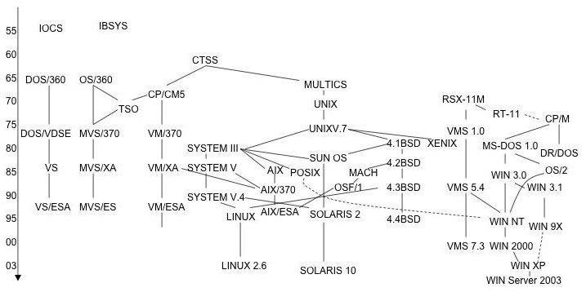
Evolution of Operating Systems
Evolution
Early Systems (1950)
Simple Batch Systems (1960)
Multiprogrammed Batch Systems (1970)
Time-Sharing and Real-Time Systems (1970)
Personal/Desktop Computers (1980)
Multiprocessor Systems (1980)
Networked/Distributed Systems (1980)
Web-based Systems (1990)
Virtualization …
https://www.cs.rutgers.edu/~pxk/416/notes/01-intro.html
1st generation 1945 – 1955
- vacuum tubes, plug boards
2nd generation 1955 – 1965
- transistors, batch systems
3rd generation 1965 – 1980
- ICs and multiprogramming
4th generation 1980 – present
- personal computers
5th generation - ???
- iniquitousness, mobile,
Notes:
5

Slide 6
Chapter 2 Reading Exercise
What are the objectives of an OS?
What services does an OS provide?
What computer resources need management?
What hardware advancements facilitated OS development?
What is JCL?
What does SPOOLing stand for?
What is a Virtual Machine? Why Virtualize?
What differentiates Windows 7, UNIX, and Linux?

Slide 7
1. What are the Objectives of an OS?
Objectives
Convenience
Make the computer more convenient to use
Efficiency
Efficient use of computer system resources
Accessibility
Uniformity
Ability to evolve
Permit effective development, testing, and introduction of new system functions without interfering with service

Slide 8
2. What Services does an OS provide?
Services
Program development
Editors, debuggers, frameworks
Program execution
Initialization, scheduling
Access to I/O devices
Uniform interface, hides details
Controlled access to files
Authorization, sharing, caching
System access
Protection, authorization, resolve conflicts
Error detection and response
Hardware errors: memory error or device failure
Software errors: arithmetic errors, access forbidden memory locations errors
Accounting
Collect statistics (billing), monitor performance (future enhancements)
Operating systems are among the most complex pieces of software ever developed...

Slide 9
3. What Resources need management?
Resource Management
Memory
Cache
Virtual
Secondary
Peripherals
Computer programs
User programs
Shared libraries
Concurrency / Synchronization
CPU cores

Slide 10
4. What H/W Advancements?
Hardware Advancements
Memory protection (1960’s)
do not allow the memory area containing the monitor to be altered by a user program.
Privileged instructions
can be executed only by the resident monitor.
A trap occurs if a program tries these instructions.
Interrupts (1956)
provide flexibility for relinquishing control to and regaining control from user programs.
Timer interrupts prevent a job from monopolizing the system.
Notes:
10

Slide 11

Characteristics of Early Systems
Early Systems
Early software: Assemblers, Libraries of common subroutines (I/O, Floating-point), Device Drivers, Compilers, Linkers.
Need significant amount of setup time.
Extremely slow I/O devices.
Very low CPU utilization.
But computer was very secure.
Notes:
11

Slide 12


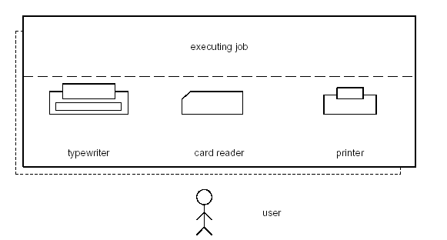
Early Systems
Early Systems
Structure
Single user system.
Programmer/User as operator (Open Shop).
Large machines run from console.
Paper Tape or Punched cards.
Notes:
12

Slide 13
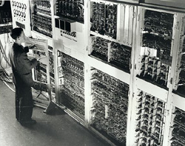
Early Computer System
Early Systems
Notes:
13

Slide 14
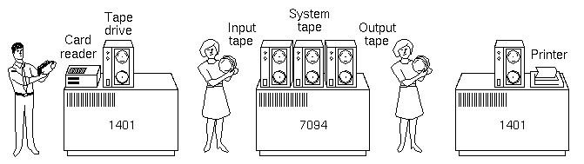
Offline Operation
Hardware Advancements
Problem:
Card Reader slow, Printer slow (compared to Tape).
I/O and CPU could not overlap.
Solution: Offline Operation (Satellite Computers)
Speed up computation by loading jobs into memory from tapes while card reading and line printing is done off-line using smaller machines.
Notes:
14

Slide 15
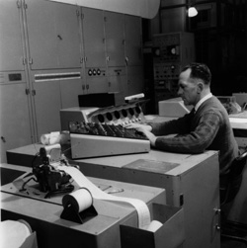
Simple Batch Systems
Batch Systems
Use of high-level languages, magnetic tapes.
Jobs are batched together by type of languages.
An operator was hired to perform the repetitive tasks of loading jobs, starting the computer, and collecting the output (Operator-driven Shop).
It was not feasible for users
to inspect memory or patch programs directly.
Notes:
15

Slide 16
5. What is JCL?
Batch Systems
Job Control language is the language that provides instructions to the monitor:
what compiler to use
what data to use
Example of job format: ------->>
$FTN loads the compiler and transfers control to it.
$LOAD loads the object code (in place of compiler).
$RUN transfers control to user program.
$JOB
$FTN
...
FORTRAN
program
...
$LOAD
$RUN
...
Data
...
$END
Notes:
16

Slide 17
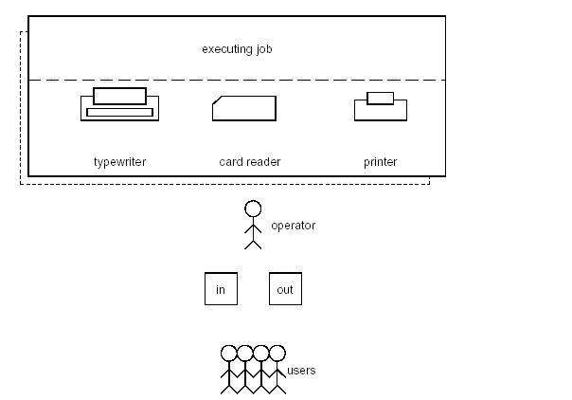
Operator-driven Shop
Batch Systems
Notes:
17

Slide 18
Simple Batch Systems
Batch Systems
The user submits a job (written on cards or tape) to a computer operator.
The computer operator place a batch of several jobs on an input device.
A special program called the monitor, manages the execution of each program in the batch.
“Resident monitor” is always in main memory and available for execution.
Monitor utilities are loaded when needed.
Reduce setup time by batching similar jobs.
Alternate execution between user program and the monitor program.
Use Automatic Job Sequencing – automatically transfer control from one job when it finishes to another one.
Rely on available hardware to effectively alternate execution from various parts of memory.
Notes:
18

Slide 19

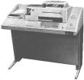
Batch Systems
Control Cards
Special cards that tell the monitor which programs to run: $JOB $FTN $RUN $DATA $END
Special characters distinguish control cards from data or program cards: $ in column 1 // in column 1 and 2 709 in column1
Notes:
19

Slide 20
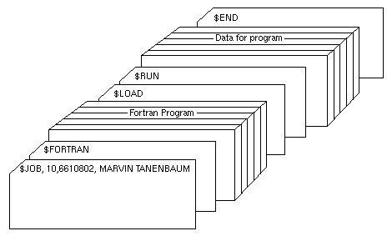
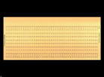

Card Deck of a Job
Batch Systems
Notes:
20

Slide 21
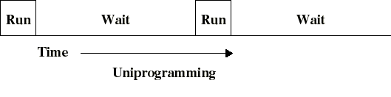
Uniprogramming
Uniprogramming
I/O operations are exceedingly slow (compared to instruction execution).
A program containing even a very small number of I/O operations, will spend most of its time waiting for them.
Hence: poor CPU usage when only one program is present in memory.
Notes:
21

Slide 22
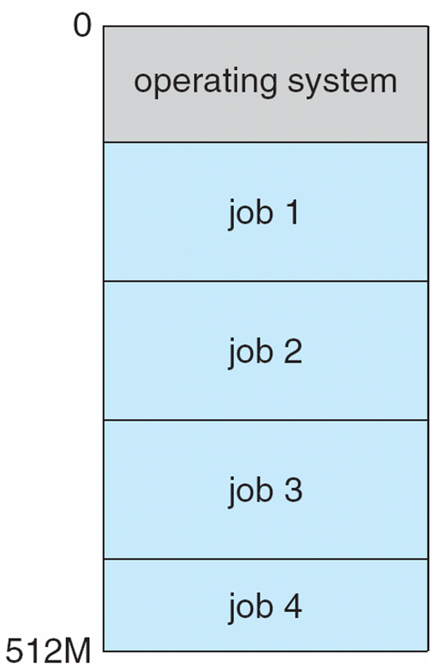
Batch Multiprogramming
Multiprogramming
Several jobs are kept in main memory at the same time, and the CPU is multiplexed among them.
Notes:
22

Slide 23
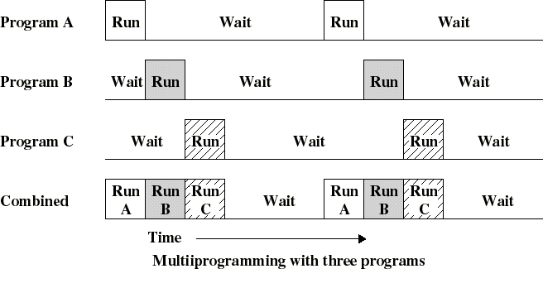
Multiprogramming
Concurrent Multiprogramming
Allows the processor to execute another program while one program must wait for an I/O device.
Notes:
23

Slide 24
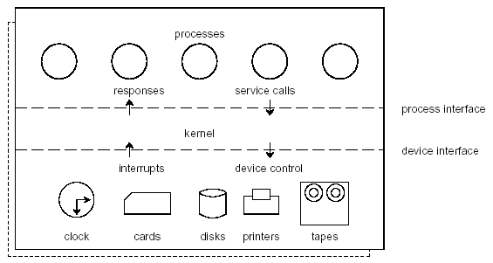
Why Multiprogramming?
Multiprogramming
Single user cannot keep CPU and I/O devices busy at all times.
Multiprogramming organizes jobs (code and data) so CPU always has one to execute.
A subset of total jobs in system is kept in memory.
One job selected and run via job scheduling.
When it has to wait, OS switches to another job.
Notes:
24

Slide 25
Multiprogramming Requirements
Multiprogramming
Hardware support:
I/O interrupts and DMA controllers
in order to execute instructions while I/O device is busy.
Timer interrupts for CPU to gain control.
Memory management
several ready-to-run jobs must be kept in memory.
Memory protection (data and programs).
Software support from the OS:
For scheduling (which program is to be run next).
To manage resource contention.
Notes:
25

Slide 26
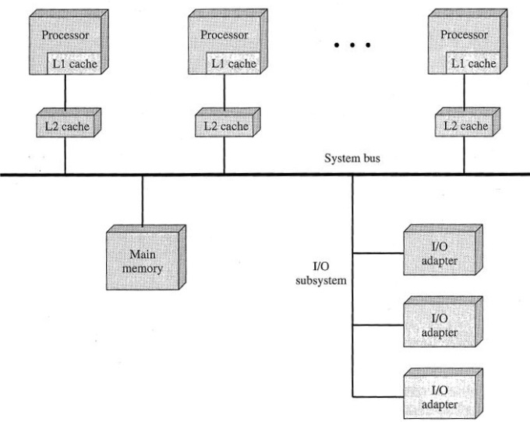
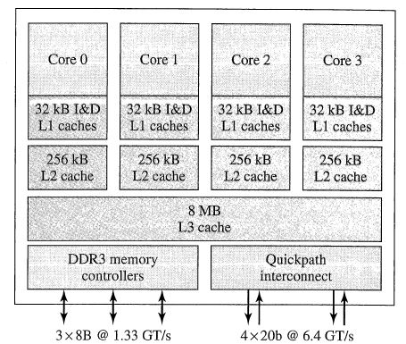
Multi (processor/core)
Multiprocessing
Traditionally, the computer has been viewed as a sequential machine.
Multiple control signals
Pipelining
Parallelism
Symmetric Multiprocessors (SMP)
2 or more identical processors that share resources
Integrated OS to control jobs, tasks, files, data elements…
High degree of interaction/cooperation between processes
Multicore Computers
Single piece of silicon (die)
Independent processors + levels of cache
Intel Core i7
Prefetching
Cluster computing
Loosely coupled - network
Client / server environment
Middleware
DME, RPC

Slide 27
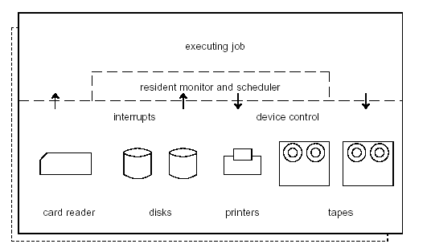
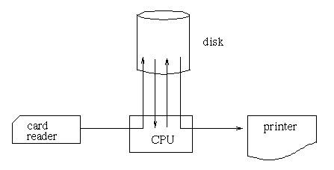
6. What does Spool stand for?
Spooling
Problem:
Card reader, Line printer and Tape drives slow
I/O and CPU could not overlap.
Solution: Spooling -
Overlap I/O of one job with the computation of another job (using double buffering, DMA, etc).
Technique is called SPOOLing: Simultaneous Peripheral Operation On Line.
Notes:
27

Slide 28
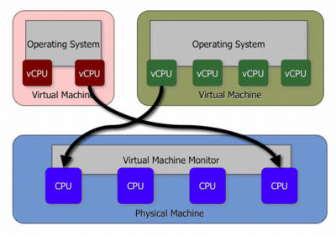
7. What is a Virtual Machine?
Virtual Machine
Virtualization technology enables a single PC or server to simultaneously run multiple operating systems on a single platform.
The host OS can support many virtual machines, each with characteristics of a particular OS.
Notes:
28

Slide 29
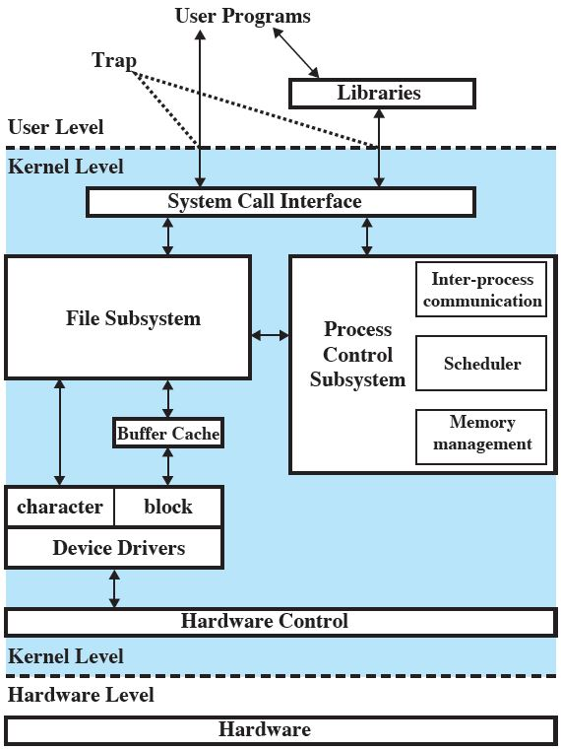
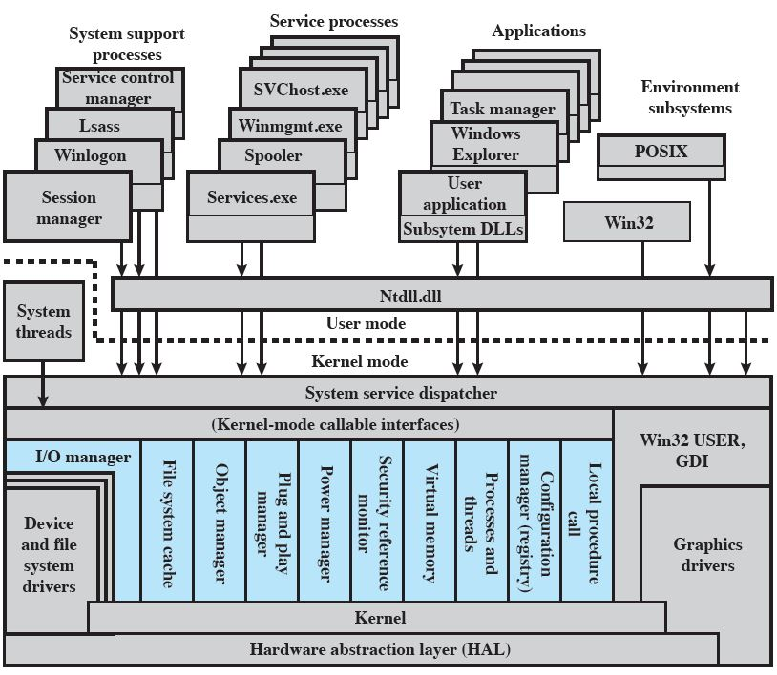
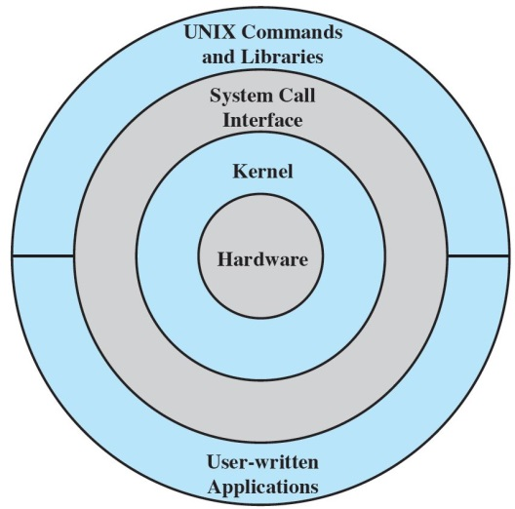
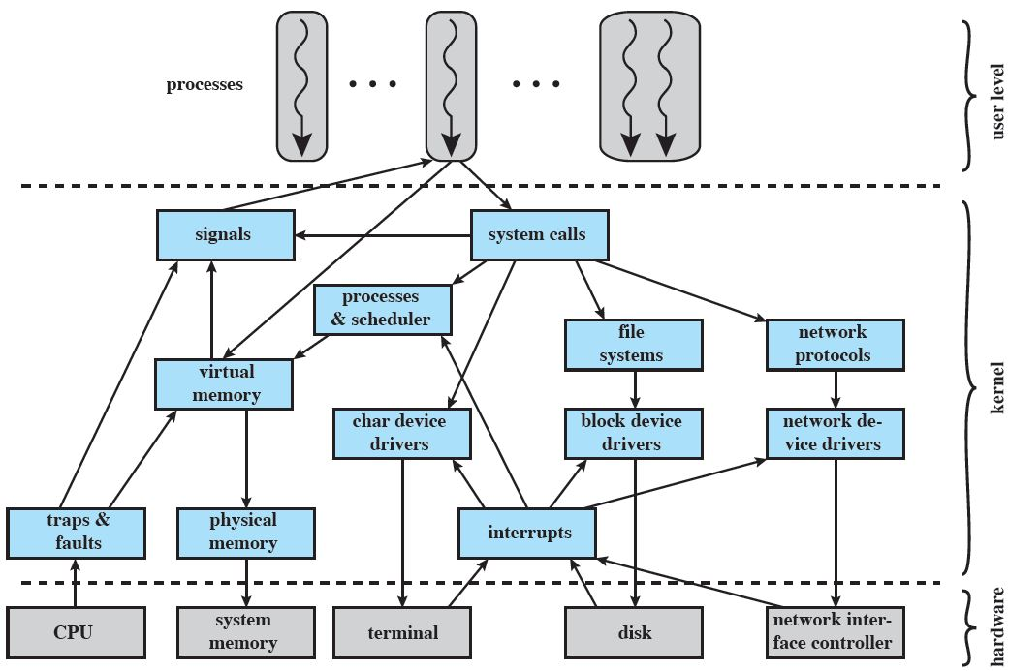
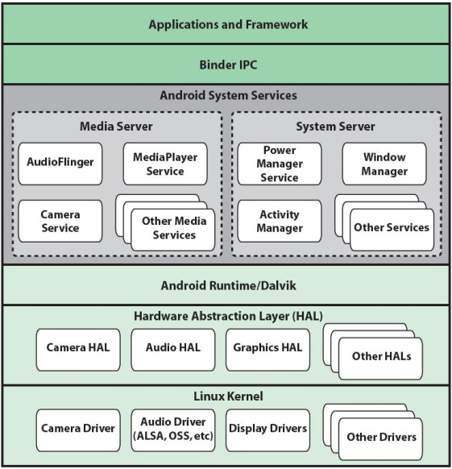
8. Windows 7, Unix, Linux?
Windows 7
Notes:
29

Slide 30
